Slide 1
Uncovering Modus Operandi from Court documents
Group F2
Cas Hortensius - Jan-Willem Tip - Jan Koetsier - Vera de Brouwer
Notes:
Intro - onderzoek - methodes (data collection, NER, problems with NER, similarity/clustering), results, conclusion, discussion

Slide 2
Agenda
Research question & problem definition
Court Sentences characteristics
Data Analysis
Validation
Conclusion
Discussion and recommendation

Slide 3
Human Trafficking Definition
Human Trafficking is the recruitment, transportation, transfer, harbouring or receipt of people through force, fraud or deception, with the aim of exploiting them for profit.
Source: https://www.unodc.org/unodc/en/human-trafficking/human-trafficking.html

Slide 4
Can we identify techniques to discover MO patterns in human trafficking court sentences?
Our research question:
Notes:
Intro - onderzoek - methodes (data collection, NER, problems with NER, similarity/clustering), results, conclusion, discussion

Slide 5

Human trafficking court documents characteristics
> 1000 results searching ‘Mensensmokkel’
Multiple court convictions regarding the same case/smuggler
Often smugglers use same route for different victims
Information in court document has low bias

Slide 6
Techniques researched
Data collection
Data analysis
NLP - NER
Text similarity
LDA - Clustering
Text summarization
Data analysis - results

Slide 7
Data Collection & its challenges
Problem:
Rechtspraak.nl’s API
Originally only able to search metadata
(date, court location, etc)
Downloading all court documents to local machine not feasible
Takes too long
Solution:
Combining rechtspraak.nl’s API with json request
Result:
Pandas dataframe
Full text per document

Slide 8
Data analysis
Named Entity Recognition:
Model trained on Dutch news documents.
No entities for detecting transportation, needed for our research question
Text similarity:
Layout of convictions always very similar, no new information provided
Text summarization:
Convictions too broad to use for summarization: All sentences calculated as important by similarity matrix
Latent Dirichlet Allocation (Topic Modeling):
Data already filtered: finding (sub)topics inside filtered data provides no new information
Notes:
Ik weet zo niet meer precies wat de reden is dat LDA niet werkt

Slide 9
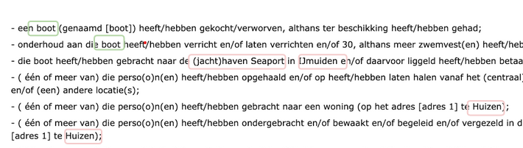
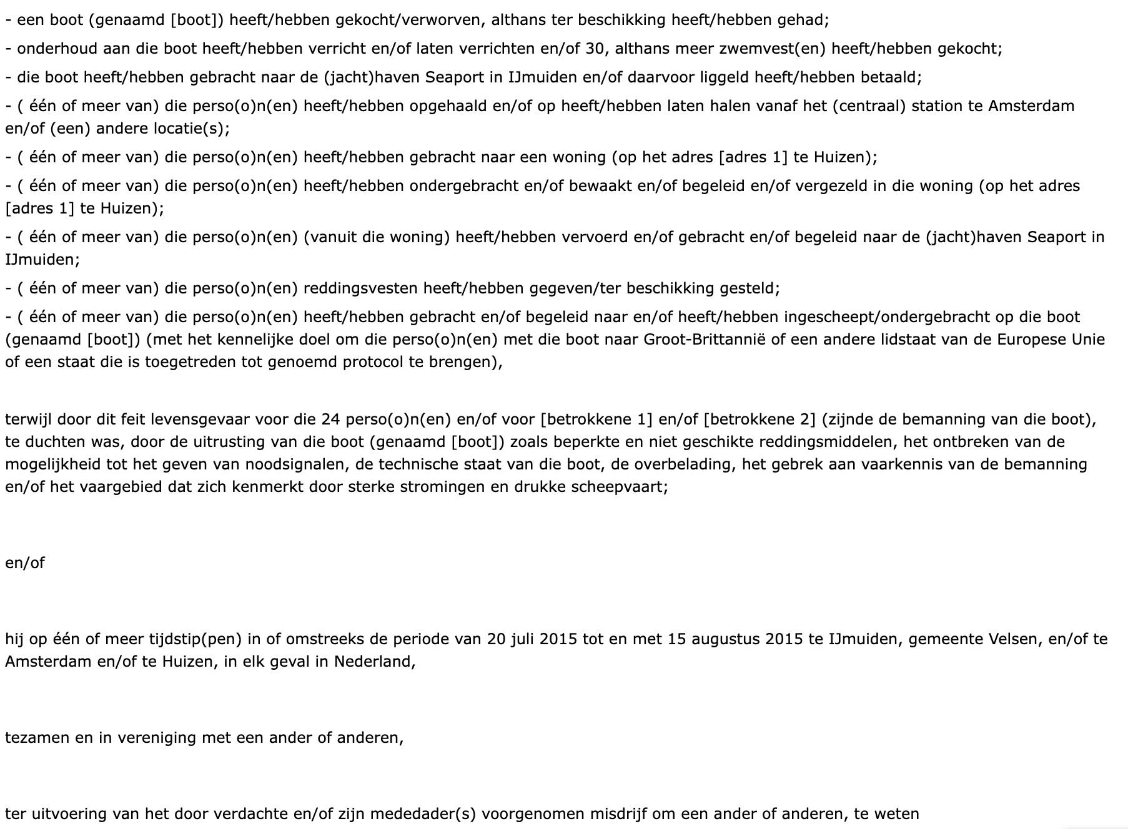
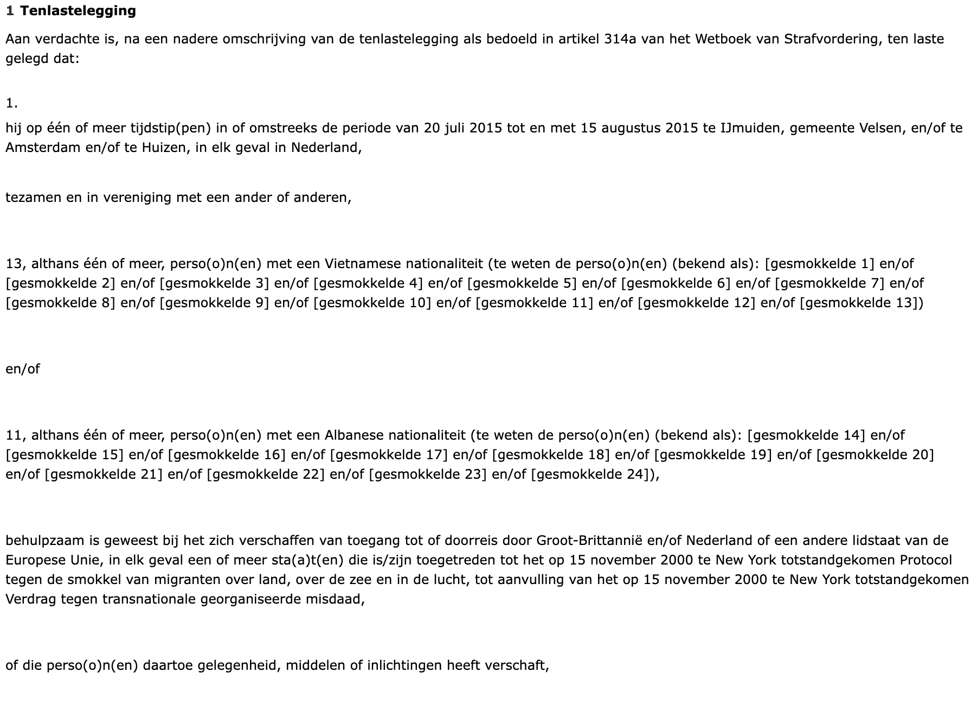
NER Example - Human traffic in court documents

Slide 10
Named Entity Recognition - Problem
Named Entity Recognition (NER) most promising, but no way to detect transportation
Providing NER model with training data:
Show model examples of transportation entities (car, boat, airplane), train model to recognize in other models
Problem called Catastrophic Forgetting occurs:
Model learns new entity, but ‘forgets’ previously learned entities

Slide 11
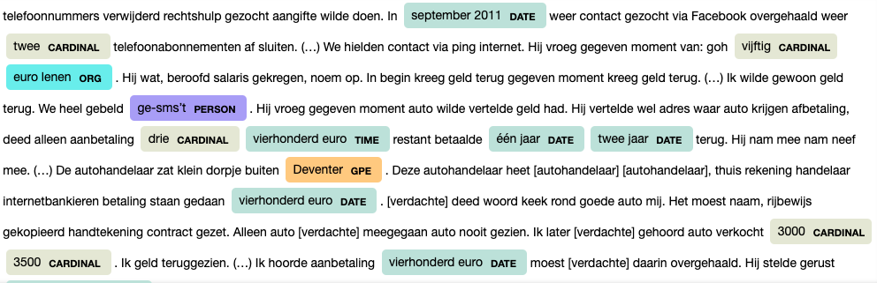
Before training

Slide 12
Before training

Slide 13
Training using examples
Label = [“VEHICLE”]
TRAIN_DATA = [
("Het voertuig is doorzocht op grond van de Wet wapens en munitie.", {"entities": [(4, 12, "VEHICLE")]})
]

Slide 14
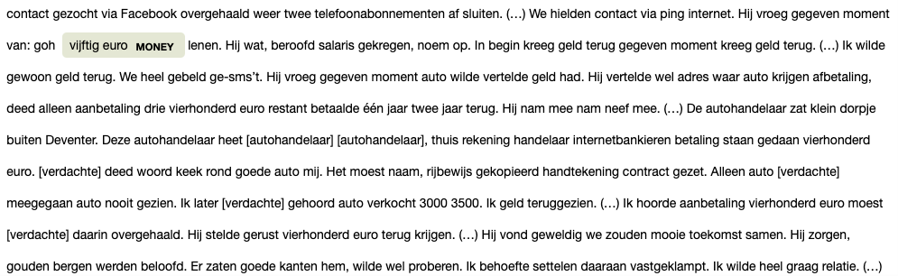
With training data

Slide 15
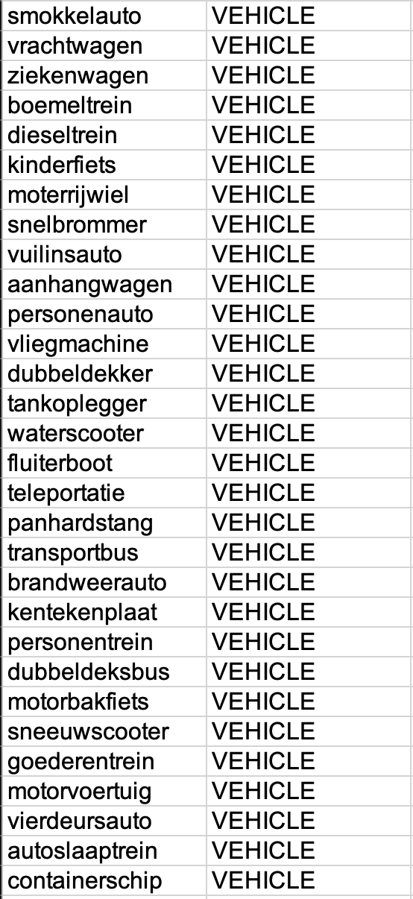
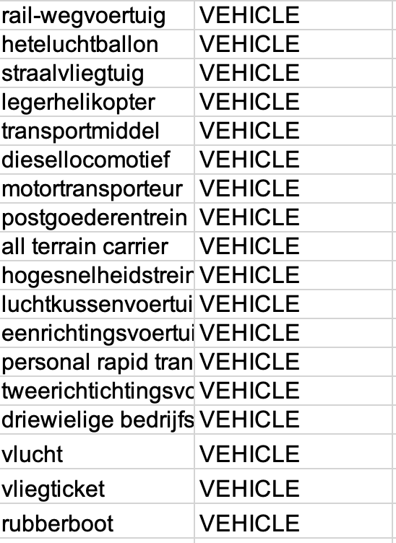
Named Entity Recognition - Solution
Rule-based entity learning
Import excel file with types and labels

Slide 16
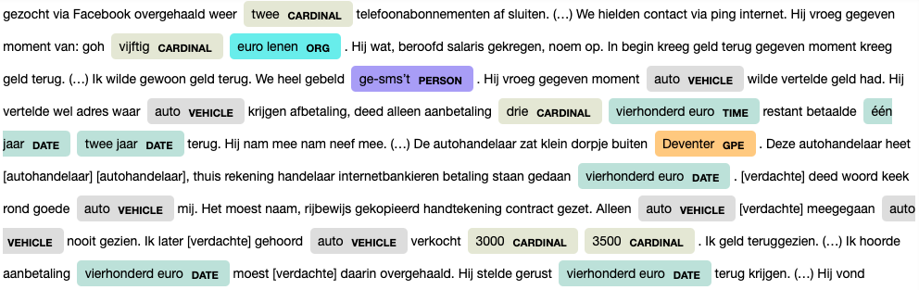
With rule-based entity training

Slide 17
Validation
How good does our model work → check with accuracy and precision
Problem:
No existing test set
Solution:
Create our own

Slide 18
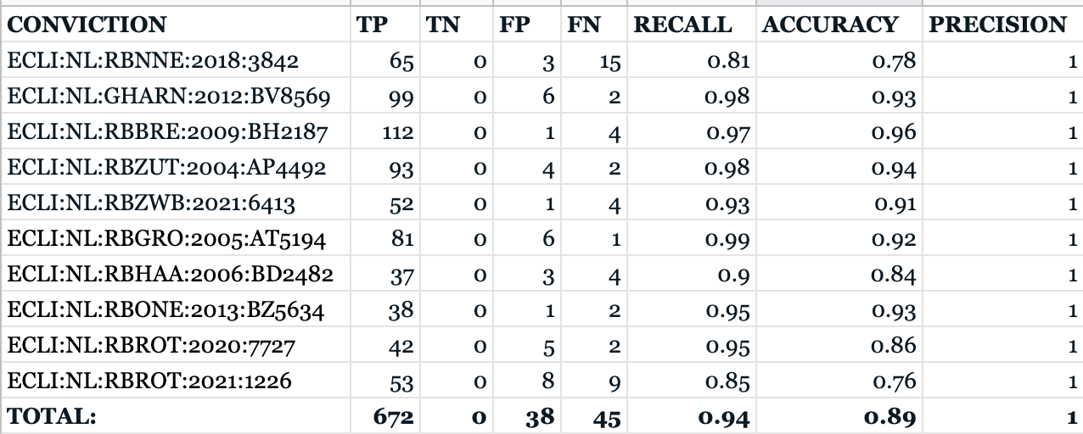
Validation
10 convictions labeled manually, then checked how many our system had correct

Slide 19
Achieved Routes
From comprehensive …
… to meaningless.

Slide 20

Clustering of court convictions
Another question: Can we find similar routes in different court convictions?
Look at similarity between routes, apply clustering algorithm.
Jaro similarity used:

Slide 21
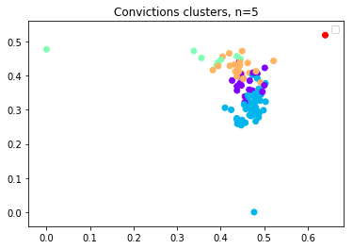
Clustering results
Convictions are all very similar in layout
No interesting results, only shows outliers
Add weights to different entity types might improve results, no success so far

Slide 22
Conclusions
Court convictions are very similar: clustering on similarity shows no significance
If a route is not present in conviction, our ‘route’ becomes meaningless.
The potential is there, a lot more tweaking is required
Be careful of implementing bias

Slide 23
Discussion - Recommendations
Train model on context
smuggling with boats → add seaport names, boatnames, etc.
Look more into relevance of words like ‘te, en/of, etc’ to find significance
Find way to find nationality of smugglers and victims

Slide 24
Thank you
Group F2
Cas Hortensius - Jan-Willem Tip - Jan Koetsier - Vera de Brouwer

Slide 25
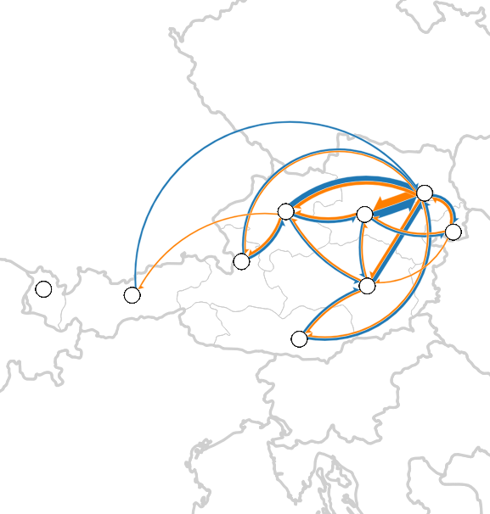
Interpretation of our goal

Slide 26
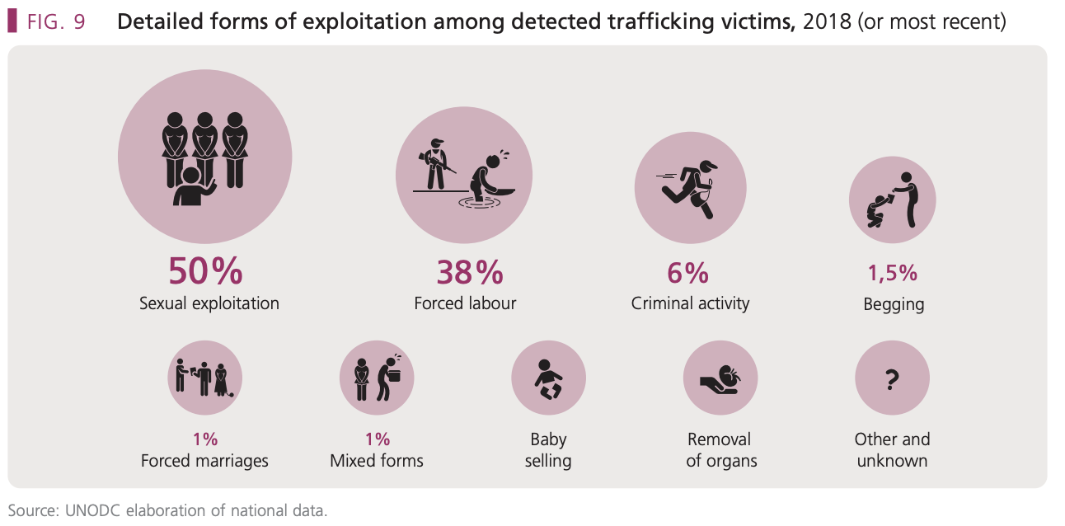
Human Traffic
2016 - 2020 4.894 registered victims of human traffic in the Netherlands
40.3 million victims worldwide

Slide 27
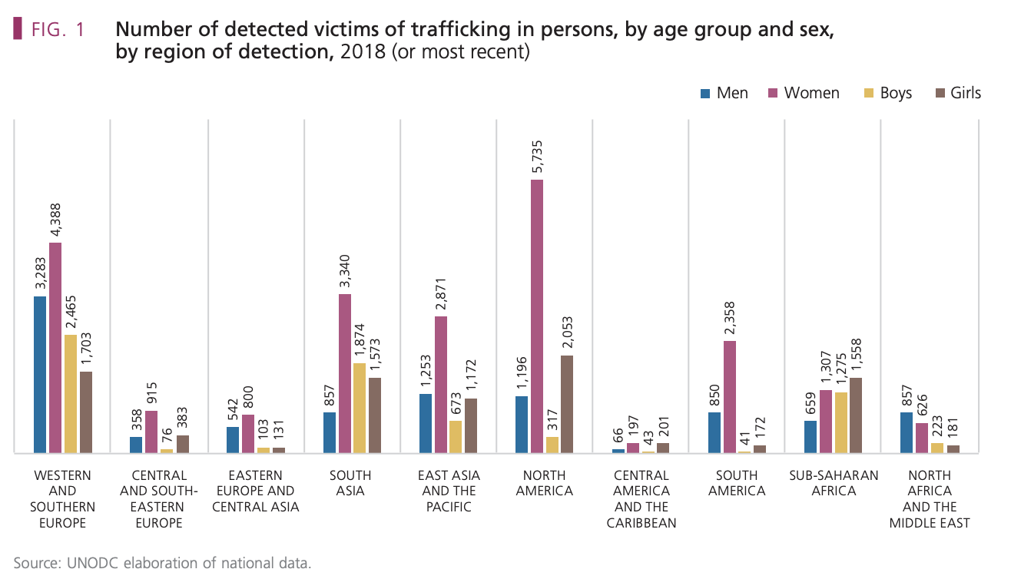

Slide 28

UNODC: Covid-19 pandemic increased these numbers, with governments diverting resources elsewhere

Slide 29
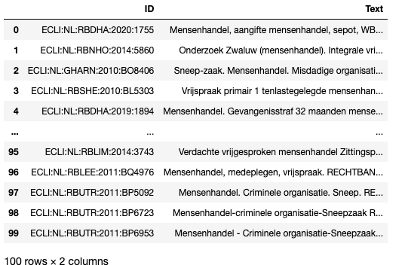

Slide 30
Human traffic in Dutch court documents

